Slide 1


School of Basic and Applied Sciences
Course Code : BBS01T1002 Course Name: Semiconductor Physics
Effective Mass and Concept of Holes
Name of the Faculty: Dr. Susmita Majumdar Program Name: B.Tech

Slide 2
Topics to be covered
:
Preliminary ideas of E-K diagram
Introduction
Derivation of Effective Mass
Concept of Holes
References

Slide 3
Objectives
Derive and apply concept of Effective Mass
Explain concept of holes

Slide 4
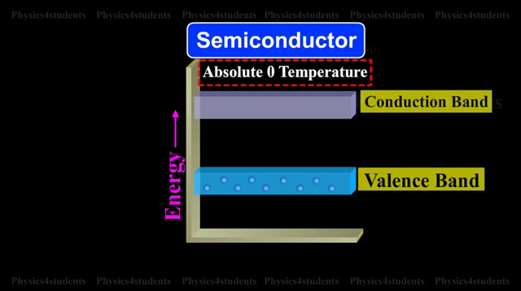

Slide 5
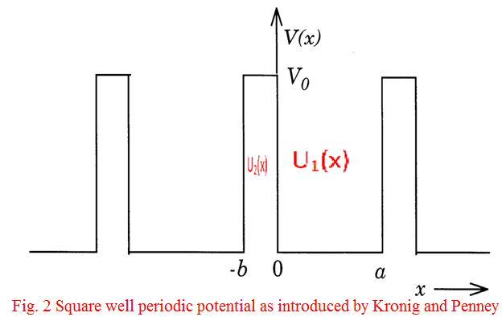
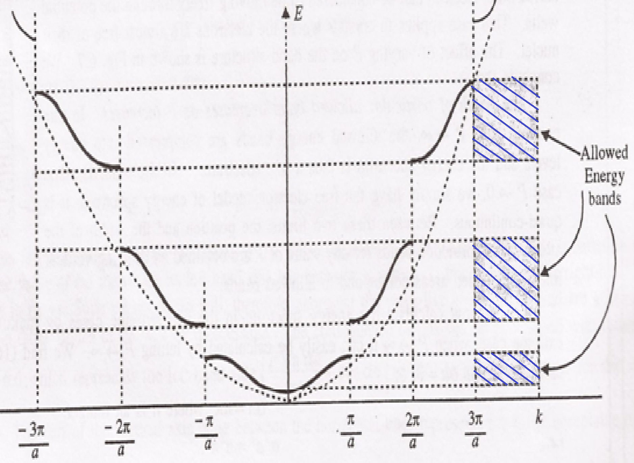
Prerequisite/Recapitulations
:
In a periodic potential lattice, the electron energy values are discontinuous, separated into allowed and forbidden zones occurring alternatively.
The width of the forbidden band increases with E.
As P decreases, the perturbations of the potential due to periodicity of the lattice vanish, making electrons really free, the discontinuous E-K graph will reduce to a continuous parabolic graph as shown by dotted lines and the forbidden bands disappear which is appropriate to the completely free particle. The dotted curve shows the parabola of free electron i.e.,
E=

Slide 6
Introduction
A free electron has well defined mass and obeys Newton’s law when accelerated by an external electric field;
When electron is in periodic potential of the crystal lattice, its behaviour in external electric field is different from that of a free electron. The deviation of the actual electron behaviour than free electron behaviour may be accounted simply by considering the electron to have effective mass, m* rather than free electron mass m.

Slide 7
Effective Mass
.
According to wave mechanical theory (de-Broglie) an electron with velocity v is equivalent to a wave packet moving with group velocity v_{g}
............................(1)
where ω is the angular frequency of de-Broglie wave and K = 2π/λ is propagation constant.
The energy of particle
Now equation (1) gives
........................................................ (2)

Slide 8
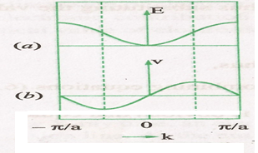
Effective Mass
For free particle,
Then, from Eqn (2)
.
This gives linear variation of v with K.
But according to band theory (with periodic potential) of electron, E is not, in general, proportional to K², there the variation of E with K is as shown in Fig.(a). Using this type of variation of E with K and using equation (2), one can calculate the velocity v, this gives a curve of the type illustrated as in Fig (b). We observe that the velocity of the electron varies with the slope.

Slide 9
Effective Mass
For K=0 and K= ± π/a, the slope, dE/dK is zero, thus the velocity of the electron is zero at bottom as well as the top of the first Brillouin Zone.
After K=0, as the value of K increases (i.e., the energy E increases), the velocity increases reaching its maximum value at K=K₀ where K₀ corresponds to the point of inflection on the E-K graph. Beyond this point the velocity begins to decrease and finally assumes the zero value at K=π/a which is the top of the band.
It is significant to note that the decrease of the velocity beyond this point of inflection (with increase in energy) and its zero value at the top of the band are the entirely new features which do not appear at all in the behaviour of free electron.

Slide 10
Effective Mass
Acceleration and effective mass of electron:
When an electron has a well defined mass and accelerated by an electric field, it obeys Newtonian mechanics. Now, we will discuss the behaviour of electron when it is to be accelerated inside a crystal due to external electric field.
.
When an electric field
is applied on the electron, then force on electron
Work done by electric field over a small distance dx travelled in time dt is
dE= -eX_{e} dx = -eX_{e} v dt
Substituting value of v from equation (2), we get

Slide 11
Effective Mass
Acceleration and effective mass of electron:
Differentiating eqn (2) with respect to time
, --------(4)
When we compare this result with the acceleration of a free electron of mass m i.e.
---------(5)
Compare eqn. (4) and (5) it follows that an electron in the periodic lattice behaves as an electron of effective mass m* given by

Slide 12
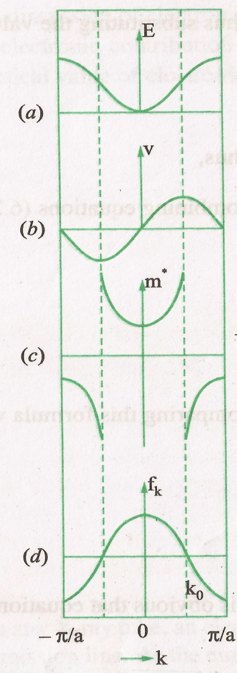
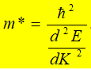
Effective Mass
Acceleration and effective mass of electron:
Clearly the effective mass of electron is determined by d²E/dK² and is a function of K is no longer a strict constant.
Fig (c) represents the effective mass (m*) of the
electron as a function of K.
It increases with increase of K, becomes maximum at point of inflexion and then it becomes negative.
m* is positive in the lower half of the energy band
m* is negative in the upper half of the energy band
At inflexion points (K=K₀) in E-K curves, the effective mass m* becomes infinite.

Slide 13
Concept of Holes
Physically it means for the region close to the top of the band that is in upper half of the band, electron behaves as a positively charged particle.
The negative mass is for the velocity decreases in upper half of the band, thus acceleration is negative i.e., opposite to the applied force, implying a negative mass. This means that in this region the lattice exerts such a large retarding force on the electron that it overcomes the applied force and produces a negative acceleration. Here the band behaves as a positively charged particle referred to as a hole.

Slide 14
Effective mass Approximation
For a free electron,
But for a periodic potential, m* ≠ m
It may be concluded that all the results of the free electron are correct provided m in each case is replaced by suitable m*. Accordingly energy in periodic potential will be given by
This is known as the effective mass approximation.
As a summary, in the periodic potential, the electron in the crystal will thus behave dynamically just like a particle with variable effective mass and the whole effect of the periodic potential on the motion of the electron is to replace the free electron mass with proper effective mass.

Slide 15
Degrees of Freedom
The degree of freedom of an electron in periodic potential is defined by a factor
f_{K} is a measure of the extent to which an electron in state K is free.
If m* is large, i.e. the electron behaves as a heavy particle. When f_{k} = 1, the electron behaves as free particle, Fig. (d) represents the plot of f_{K} against K. It may be noted that f_{K} is positive in the lower half of the band and negative in upper half.

Slide 16
Practice Questions
Show that the effective mass of an electron in a crystal is inversely proportional to the second derivative of E-k curve.
Under what conditions the effective mass of an electron becomes +ve, -ve and infinity. Give the relevant figure.
What is effective mass approximation? Derive an expression for effective mass of an electron in a periodic potential? Show its variation with wave number (k).
What is degree of freedom for an electron in a periodic potential? Plot it as a function of wave vector ‘k’.

Slide 17
School of Basic and Applied Sciences
Course Code : BBS01T1002 Course Name: Semiconductor Physics
References
1. J. Singh , Semiconductor optoelectronics, Physics and Technology, Mc-Graw –Hill Inc. 1995.
2. S.M. Sze, Semiconductor Devices: Physics and Technology, Wiley 2008.
3. Pillai S O, Solid State Physics,( 2010), sixth edition, New Age International (P) Ltd. ISBN-9788122427264.
4. https://www.youtube.com/watch?v=lLScPVAWTXI

Slide 18
School of Basic and Applied Sciences
Course Code : BBS01T1002 Course Name: Semiconductor Physics
Thank you
Name of the Faculty: Dr. Susmita Majumdar Program Name: B.Tech

